Slide 1

Job Finder App : Find
Dream Job
Presented by Lucky Chauhan

Slide 2




ABOUT
WHO ARE WE ?
We are five individual contributing together under the name "Dream Job Finder " . We are highly motivated towards team work and contributing for the project we work upon. Apart from being teammates we are classmates too, so we share a good work-culture while working . We are here to present ourselves as a team, to step ahead contributing to best possible extent.
02

Slide 3
Dream job finder
ABOUT OUR PROJECT
DEFINE
Dream Job Finder is a career-focused platform that helps students and job seekers reach their goals by offering domain-specific roadmaps, interview prep materials, resume tips, and company-specific insights. It simplifies the job search with easy-to-understand content, skill checklists, and portfolio guidance—empowering users to confidently prepare and land their dream job.
03

Slide 4
THIS PROJECT ?
WHY
IDENTIFY
WHy
Our Approach : The objective of Dream Job Finder is to bridge the gap between aspiring candidates and their career goals. By offering structured roadmaps, company-specific preparation strategies, and essential resources like resume-building tips and mock interview guidance, it ensures users are well-prepared for the job market. The platform focuses on simplifying the preparation journey, helping users build confidence and clarity as they pursue their dream roles.
THiis?
04

Slide 5
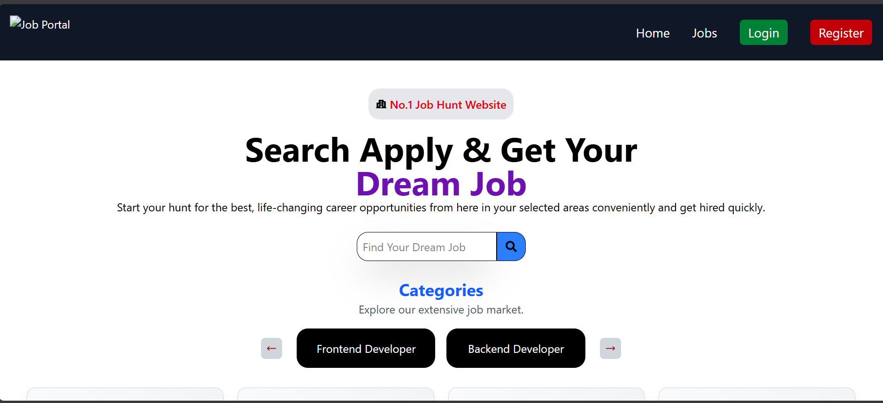

IDEOLOGY
OuR
CONCLUSION
Dream Job Finder is a one-stop platform designed to support students and job aspirants by providing well-structured resources like handwritten notes, exam prep materials, and previous year papers. Its user-friendly interface helps users easily access reliable content, saving time and boosting learning efficiency. This ultimately enhances their preparation and increases their chances of landing their dream job.
05

Slide 7
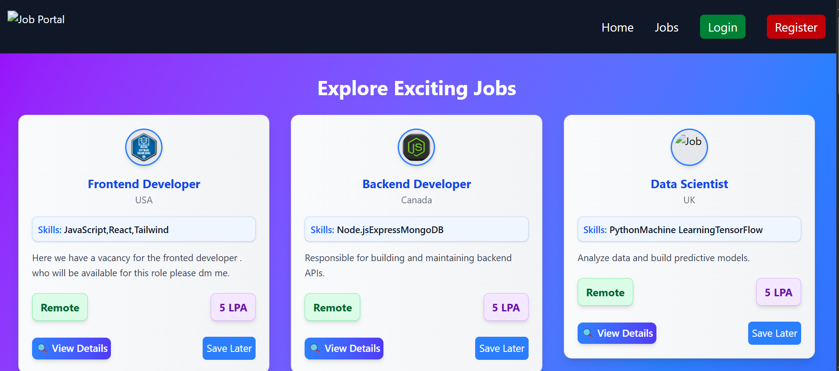
Jobs

Slide 8
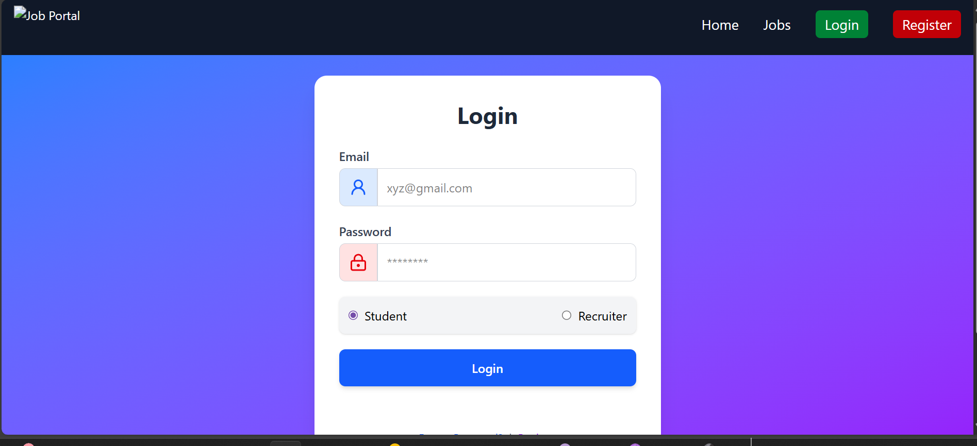
Login Page

Slide 9
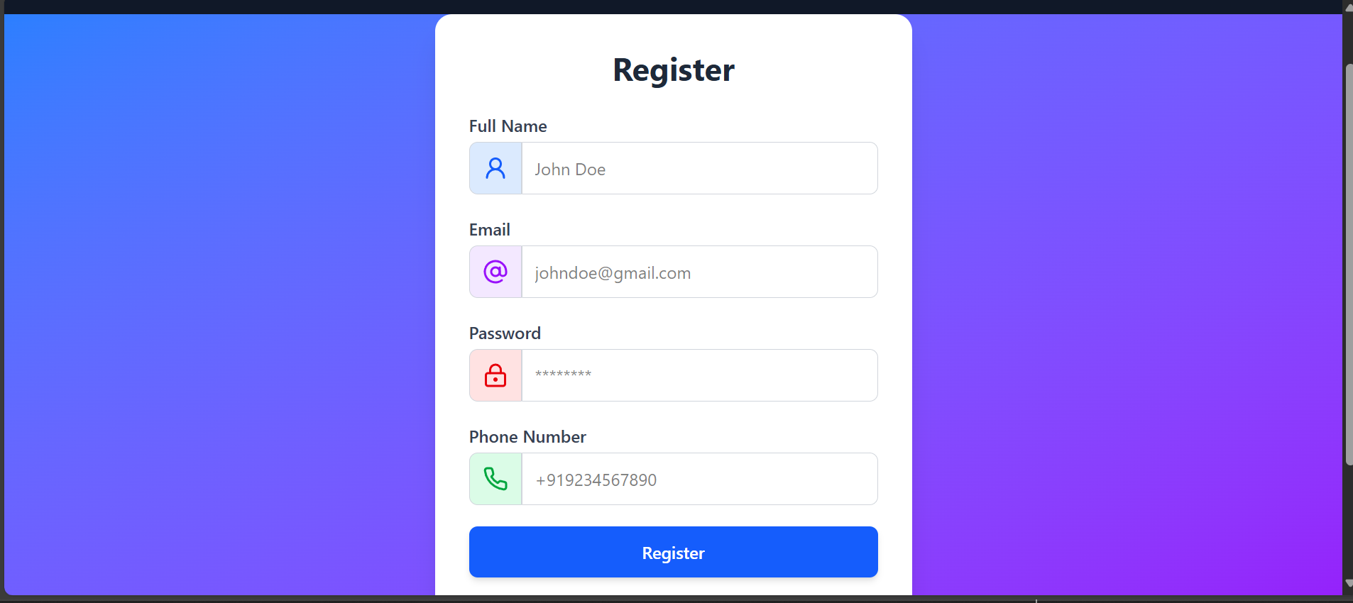
Register Page

Slide 10
PROJECT
PROCESS
STEP 6
STEP 1
STEP 2
STEP 3
STEP 4
STEP 5
Selection Of Problem Statement
Understanding and Analyzing Project Requirements
Producing Concept Plan
Designing and Prototyping Phase
Development
Testing and Deployment
09

Slide 11
PROJECT
TOOLS AND TECHNOLOGIES

Slide 12
CHECKOUT EDUWISE
Live Source code

Slide 13
THANK YOU
"Front-end developers breathe life into ideas, transforming concepts into interactive realities."

